Slide 1
Topic 0 – About this Course

Slide 2
Course Content
This class is NOT programming courses
But you need the basic ability of Java programming.
The idea is to provide you with concepts: tools you need to write efficient programs
The programming language you use and the way you implement these ideas is up to you
You will learn efficient structures for storing information and handy algorithms for manipulating that information

Slide 3
What the course is about
There are four main, interrelated topics in this class:
Recursion
Data structures
Algorithms
Analysis of algorithms
In addition, we will continue to explore good programming practices
Good programming style
Good habits, such as creating test cases
Use of tools, such as Eclipse and Junit
It will also be necessary to cover more Java

Slide 4
Java in this course
This is a course in algorithms and data structures, not a second course in Java
But...
Java will be the primary programming language
We will study Java Collections in detail, as they are extremely relevant to the course
You will be expected to use Visual Studio or Eclipse 3.1M4 or newer (the current version is 3.1.1)
Eclipse 3.0 does not support Java 5.0

Slide 5
Java Collections
Java Collections implement many of the most important data structures for you
A traditional data structures course would have you implement these yourself
I don’t believe in re-inventing the wheel
However, you need to know how these data structures are implemented, for the times when you need something more than Java gives you

Slide 6
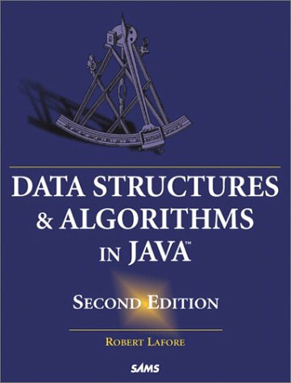
Required textbook
Data Structures & Algorithms in Java, Second Edition, by Robert Lafore
This book has the clearest and most understandable explanations of algorithms that I have ever seen
It does not, however, cover some of the essential math we will need

Slide 7
Recommended book
Data Structures and Algorithm Analysis in Java, 3rd Edition, Mark Allen Weiss
数据结构与算法分析：Java语言描述（原书第3版），马克·艾伦·维斯 著，陈越 译，出版社： 机械工业出版社
Reasons for recommendation: it has Chinese version

Slide 8
Grading
We will have:
Several homeworks
Several programming assignments
No midterm
One final exam
Score will be weighted as follows:
5% attend
We will call the roll, and one point will be deducted
5 points will be deducted at most
5% homeworks
30% assignments
60% final exam

Slide 9
Assignments
Except as otherwise noted, all assignments:
Are to be done solo (by yourself).
As before,
You may discuss the assignments with other students
You may help (and get help with) debugging
You may not give your source code to anyone
Should be done in Visual Studio or Eclipse
Should include complete JUnit tests, and
Should include complete javadoc documentation

Slide 10
Assignments
I think that each assignment can be done on our class.
So…
Late assignments will lose 5 points per day, and may not be accepted if more than a week late

Slide 11
Office hours and (no) labs
If you have any question,
you can send an email to me
cklin@fzu.edu.cn
or we can build a QQ group for share the slides
Basically, I don't answer any personal question
Because your questions in the course may also be the questions of others
So please ask them in the group
I will answer in the QQ group or in our class

Slide 12
If you are interested in going abroad for Master Degree
I can write a letter of recommendation
Especially if you are interested in studying in Taiwan
In Taiwan, you can obtain the Master Degree in two years.
Or join my research lab to study and write papers

